Slide 1
Ds-2 Tableau project_Nasuh
File created on: 28-Oct-23 11:25:12 AM

Slide 2
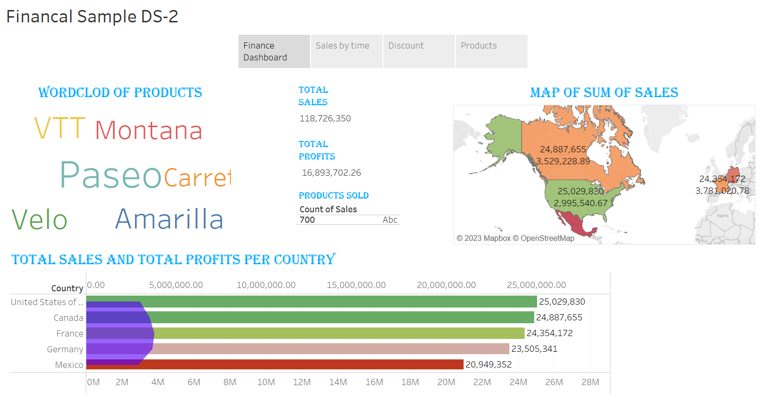

Slide 3
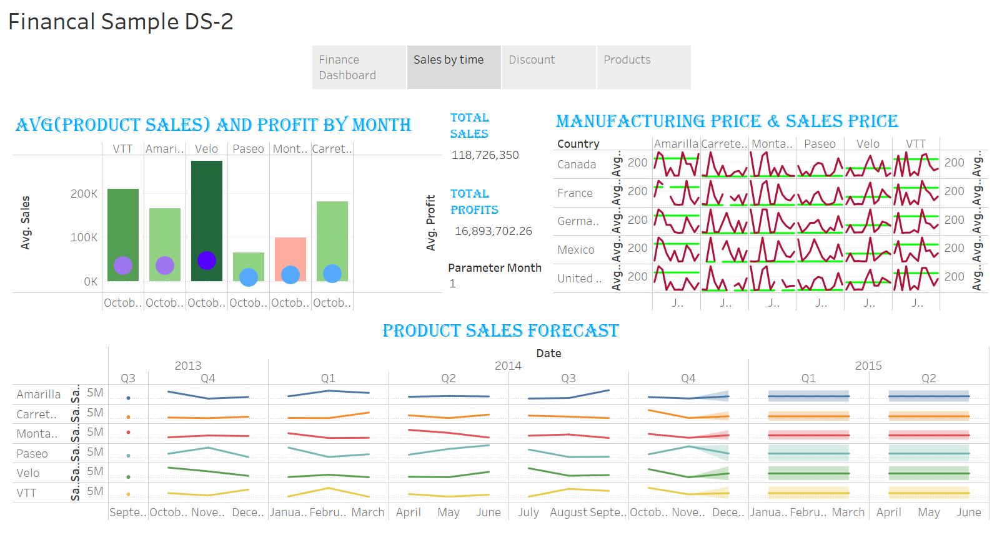

Slide 4
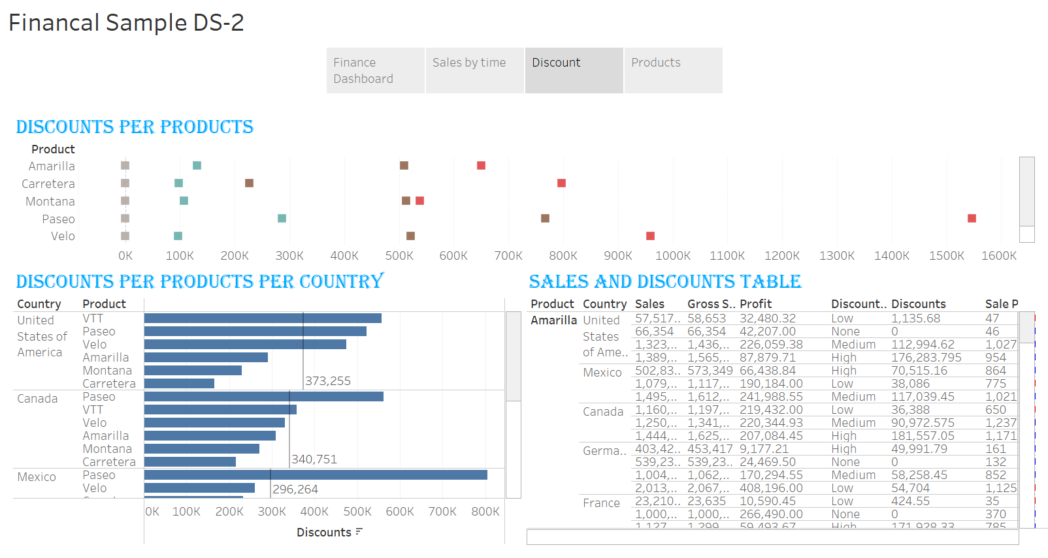

Slide 5
